Slide 1
DRC Challenges with Multiple Surveillance Systems
How to make decision from multiple surveillance data sources

Slide 2
Overview
DRC context
National Surveillance System
Different Surveillance Systems
EPI surveillance system
Challenges to multiple surveillance systems
Perspectives

Slide 3
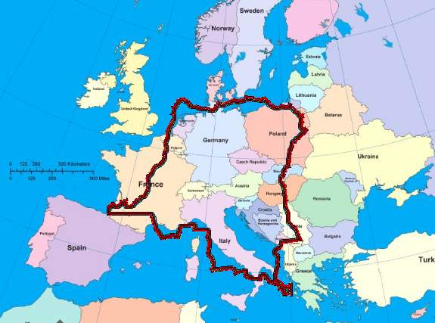
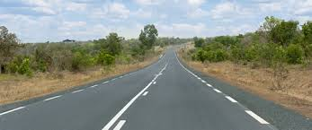
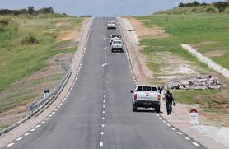
1.DRC Context
Surface: 2 .345.000 Km2
Country subdivided in 26 regions with 517 Health Districts.
Maternal and infants mortality rates in regression: 148/ 1000NLB(EDS 2010) to 104/1 000 NLB (EDS II 2013-2014)
Routine immunization in progress
Country certified free of poliovirus circulation by the ARCC in November 2015 (4 years without detection of WPV)
Measles follow up campaigns organized in 2013 and 2014
Measles follow up campaigns planned for July 2016
Strategic plan of measles elimination 2013-2020

Slide 4
½ MAP OF SUBDIVISION OF DRC IN 26 REGIONS UNTIL 2015
Population total:
89 046 900
Population under five year: 16 829 864 (18,9%)
Population under one year: 3 561 876 (4%)
Nord Ubangi
Bas Uele
Sud Ubangi
Haut Uele
Mongala
Ituri
Equateur
Tshopo
Tshuapa
Nord Kivu
Mai Ndombe
Maniema
Sankuru
Sud Kivu
Kwilu
Kasai
Kongo Central
Kasai Oriental
Lomami
Kwango
Tanganyika
Haut Lomami
Katanga
Lualaba
Haut Katanga

Slide 5
1/3 Structures of Health system and vaccination in DRC
Ministre
Building health policy and follow up and national coordination
General
National Level
D1
D2
DLM
D13
EPI Nat.
Provide technical support and follow up and evaluation of strategy planned
Health Prov Division
11Coor. EPI
Sub national level
44 Ant.EPI
Health Facility level : implement the national health policy by giving minimal package activities as well as vaccination
516 HZ CENTRAL OFFI
Operational level
8.830 Health Zones
5

Slide 6
2. National Surveillance in DRC
Health Zones offices (Doctors, Nurses, Community Leader)
Health Centers, Hospitals (Nurses, Doctors)
Sub Level (4th office, EPI coordinators, EPI antenna)
Communities (CR, PA, Traditional Healers)
National Level ( 4th direction, EPI direction )
To search for suspect cases during home visit with a simple definition
Active search, investigation, reporting to Central office of Health Zone
Active search , active monitoring, investigation, validation of cases, feed back, reporting to sub level
Directives, Active monitoring, investigation, reporting to national level, feed back to health Zones
Analyze, Active monitoring, Investigation, retro information,

Slide 7
3. Different Surveillance Systems in DRC
In DRC each program has his own surveillance system: (Vaccine preventable diseases, Malaria, TB, HIV, etc)
Each of these systems has own data collection tools
Same reporting sites (health facilities)
Same reporting flow
However all are conducted by 4th Direction
( Direction of control diseases)
National system sanitary information(very huge)

Slide 8
3/1. Description of Network surveillance
ISDR :Integrated Surveillance Disease and response
The 4th Direction is responsible of all diseases surveillance throughout DRC.
~17 outbreak-prone diseases with weekly notification
Includes measles and others VPDs ( Polio, Yellow fever, Measles, Tetanus, etc…)
Primary purpose is to identify the abnormal increase in cases over the base line
This surveillance is based on the attendance, it doesn’t give details on the case

Slide 9
3/2:Description of Network Surveillance
Investigated after the confirmation cases by laboratory diagnosis
Data collection tools
Health facilities are reporting weekly on 17 outbreak-prone diseases
Reported to the office of Health District which report to the regional level after the regional level send to the national level.
Taking time to take decision
Health facilities delay reporting

Slide 10
4. EPI Surveillance system
EPI uses ISDR reported each week
Second system built on the AFP surveillance system for other VPDs (measles, yellow fever, tetanus, etc.)
EPI added data collection tools to obtain data on status of vaccination
Using community to detect the cases
Identical reporting
Case-based surveillance contains information about person, age, sex, status of vaccination, issue.
Can use for main analysis and localization of cases

Slide 11
5.Challenges
Multiple data collection tools
Poor data quality
Delay in detecting cases
Lack of coordination of different financial resources of surveillance
Lack of prioritization of surveillance by the community
We must sustain case-based, active surveillance but hard
Must start including others VPDs, such as yellow fever and neonatal tetanus

Slide 12
6. Perspectives
Reinforce the national system of sanitary information
Harmonization between integrated diseases surveillance and cases based systems
Strengthen the surveillance system in the way of the effective elimination of measles by 2020 (DRC strategic plan of measles elimination 2013-2020

Slide 13
Thanks very much for your attention

